Slide 1
PC Maintenance: Preparing for A+ Certification
Chapter 3: Case, Electricity, and Power Supplies

Slide 2
Chapter 3 Objectives
Select an appropriate case for a PC
Understand electrical basics
Select an appropriate power supply
Troubleshoot a PC using electrical testing
Select appropriate power conditioning and backup devices

Slide 3
Selecting a Case
Construction
Form Factor (AT, ATX)
Number of drive bays
Power supply (if included)

Slide 4
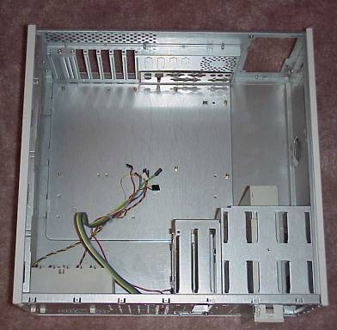
Case Form Factors
ATX:
  Loose wires coming from power switch, will connect to motherboard later
  Bezel for the motherboard’s built-in I/O ports in back

Slide 5
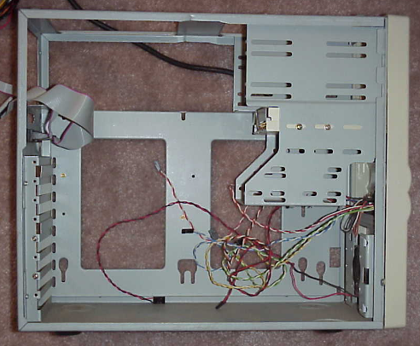
Case Form Factors
AT:
  Power switch connects to power supply
  Slots in case floor for plastic stand-offs

Slide 6
Drive Bays
 | Internal | External
Small | Hard disk | 3 ½” floppy ZIP drive
Large | Some older hard disks | CD 5 ¼” floppy

Slide 7
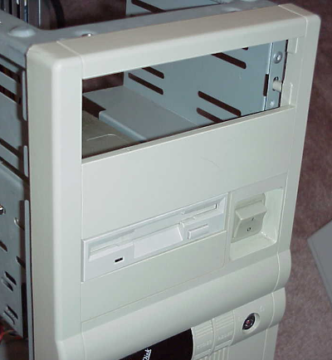
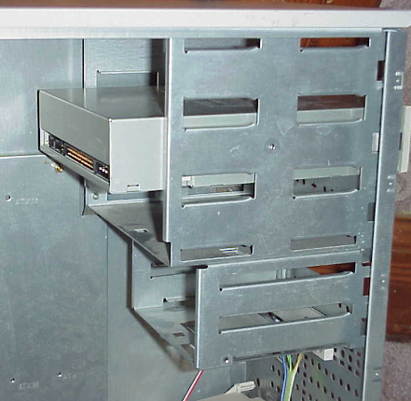
Drive Bays

Slide 8
Electricity Basics
Voltage
Current
Wattage
Resistance

Slide 9
Voltage
Difference in charge between the positive and negative poles
Can be positive or negative volts (v)
Ordinary household current is 110v in the USA, or 220v in most of Europe

Slide 10
Current
Measurement of the volume of electricity
Measured in amperes, or amps
Controlled by the device that is drawing the current

Slide 11
Wattage
Derived by multiplying voltage and current
Examples:
  5 amps of +12v power = 60 watts
  1.5 amps of +5v power = 7.5 watts
  10 amps of +3.3v power = 33 watts

Slide 12
Resistance
Amount of obstacle in the electricity’s path
Measured in ohms (Ω)
Resistance of less than 20 ohms required for electrical operation
Infinite ohms ( ∞ ), no connection

Slide 13
Grounding
Creating a path of little resistance to the ground
Acts as a protection against over-voltage
Achieved by the third prong in an outlet plug

Slide 14
AC and DC
AC: Alternating Current
  Ordinary household current
  Alternates positive and negative poles at 60 Hz
  Good for sending power over long distances
DC: Direct current
  Batteries
  Positive and negative poles stay fixed
  Lower overhead
  Portable

Slide 15
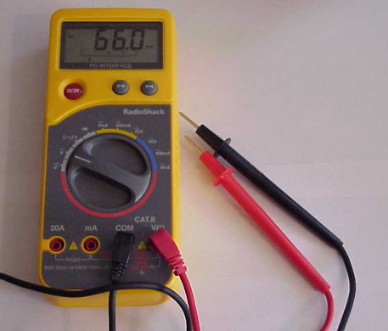
Electrical Measurements
Analog multimeter
  Uses a needle gauge
  Continuously variable
Digital multimeter
  Uses a digital display
  Precise values
  More suitable for computers

Slide 16
Measuring Resistance
Set multimeter to ohms
Place probes on either end of the wire or circuit in question

Slide 17
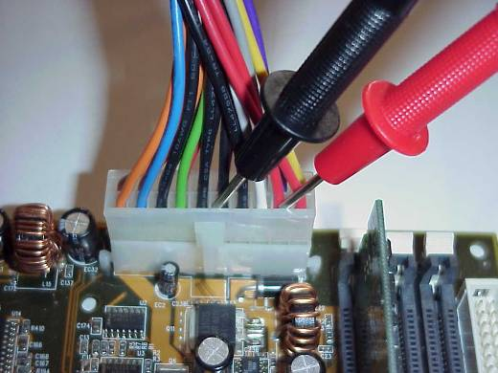
Measuring Voltage
Must be measured with computer on
Use back-probing
Place black probe on grounding wire (black)
Place red probe on wire to be tested

Slide 18
Measuring Current
Must be measured with computer on
Multimeter must be placed in-line
Difficult to do with most computer components

Slide 19
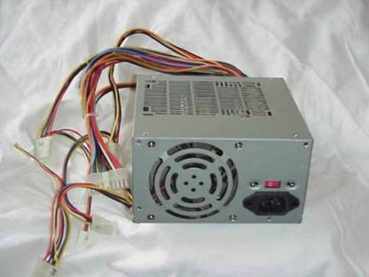
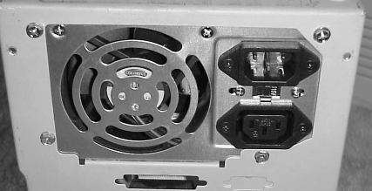
Types of Power Supplies
Form factor
  AT
  ATX
  Other sizes
Wattage

Slide 20
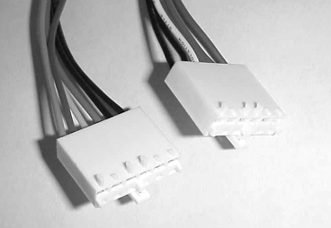
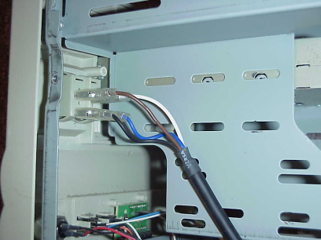
AT Power Supply
P8 and P9 connectors to motherboard
Power switch attached directly
+5v, -5v, +12v, and -12v power

Slide 21
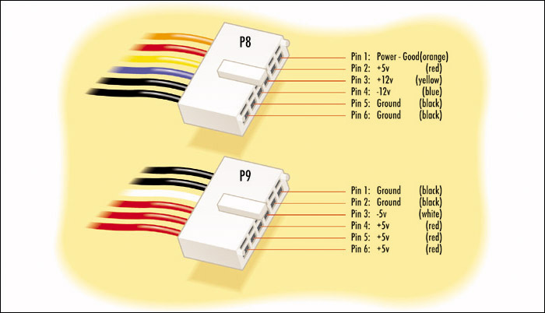
AT Connectors

Slide 22
ATX Power Supply
Single 20-wire connector to motherboard
No direct connection to power switch
+5v, -5v, +12v, -12v, and +3.3v power

Slide 23
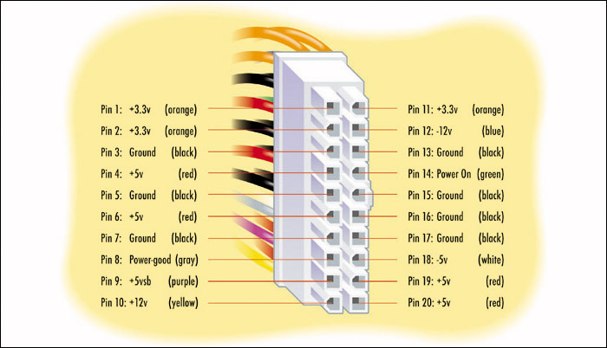
ATX Power Supply Wires

Slide 24
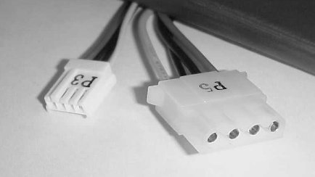
Power Supply Connectors
Molex
  Used for most drive types
Mini
  Used for 3.5” floppy drives

Slide 25
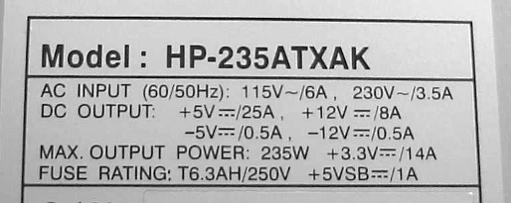
Determining Wattage Requirements
Read label on power supply
Calculate wattage drawn by each component
Compare total amount drawn to label

Slide 26
Failed Power Supply
Fan won’t spin
Inconsistent power provided (fan revs and sags)
System will not boot (appears dead)

Slide 27
Overloaded Power Supply
Typically overloads at startup
Problems occur when drives spin up
System may spontaneously reboot when multiple drives are accessed

Slide 28
Testing a Power Supply
Check voltage on the Power_Good pin
  AT: Pin 1 on P8 (orange wire)
  ATX: Pin 8 (gray wire)
Use back-probing
Range should be +3v to +6v

Slide 29
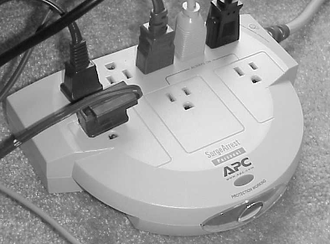
Surge suppressor
  No backup power
  Protects from damage due to spikes
  Does not protect from damage due to sags

Slide 30
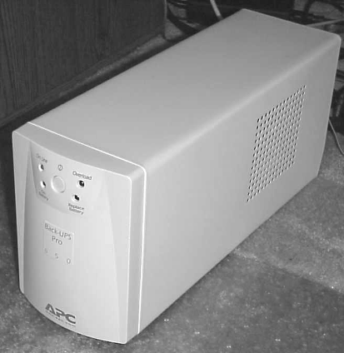
Uninterruptible Power Supply
Standby UPS
  Serves as surge suppressor
  Switches to battery backup when needed
Online UPS
  Serves as a surge suppressor
  Runs constantly on battery, recharged from AC

